Slide 1
Water Pump Presentation
For Tanzania Ministry of Water

Slide 2
Agenda
Project Proposal
Initial Hypotheses
Project Approaches
Data Insights
Insights Discussion
Recommendations and Actions

Slide 3
Project Proposal for Tanzania Ministry of Water
Pinpoint any location/areas that has water pump breakdowns
Discover which management types affecting pump maintenances
Examine water extraction techniques, water sources and water points for relationships
Create a machine learning model for prediction

Slide 4
Initial Hypotheses
Geographic locations such as Basin, Subvillage and Region will provide pump statuses
Populations density throughout Tanzania are equally distributed
Water source, types, quantity and quality are consistent in all water pumps

Slide 5
Project Approaches
Location analysis will use basin, sub village, region, region code and district code features. Extra information can be gleaned from gps height, longitude and latitude.
Population will use population and public meeting columns
Source, source type, source class, waterpoint type, waterpoint type group columns will be explored to see any connection to pumps
Metrics will be used are accuracy, precision, recall and F1 scores since this is binary outcome

Slide 6
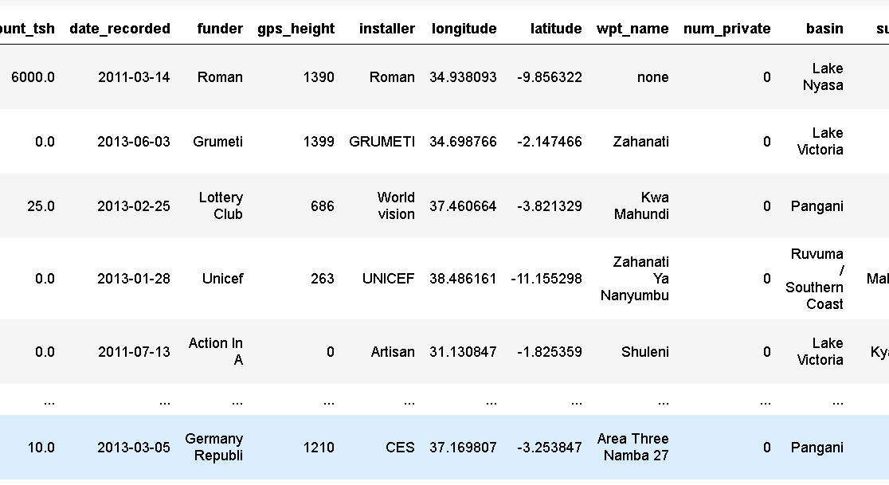
Dataset Overview
Dataset Size:
59400 rows
41 columns

Slide 7
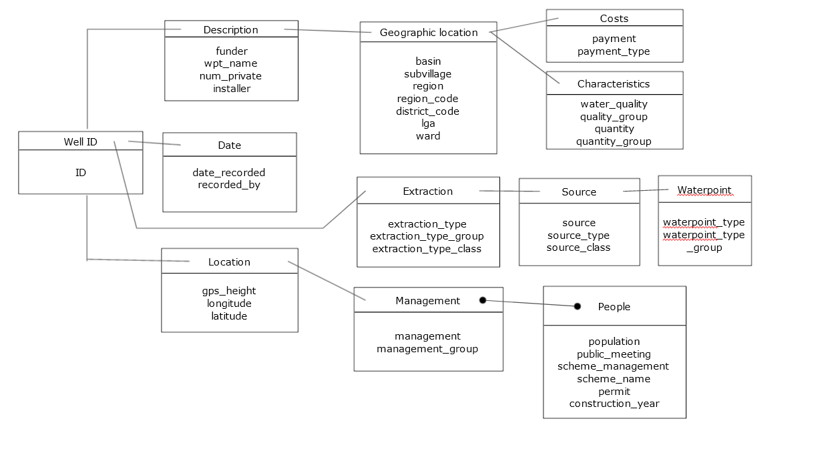
Entity Relationship Diagram

Slide 8
Insights Discovered

Slide 9
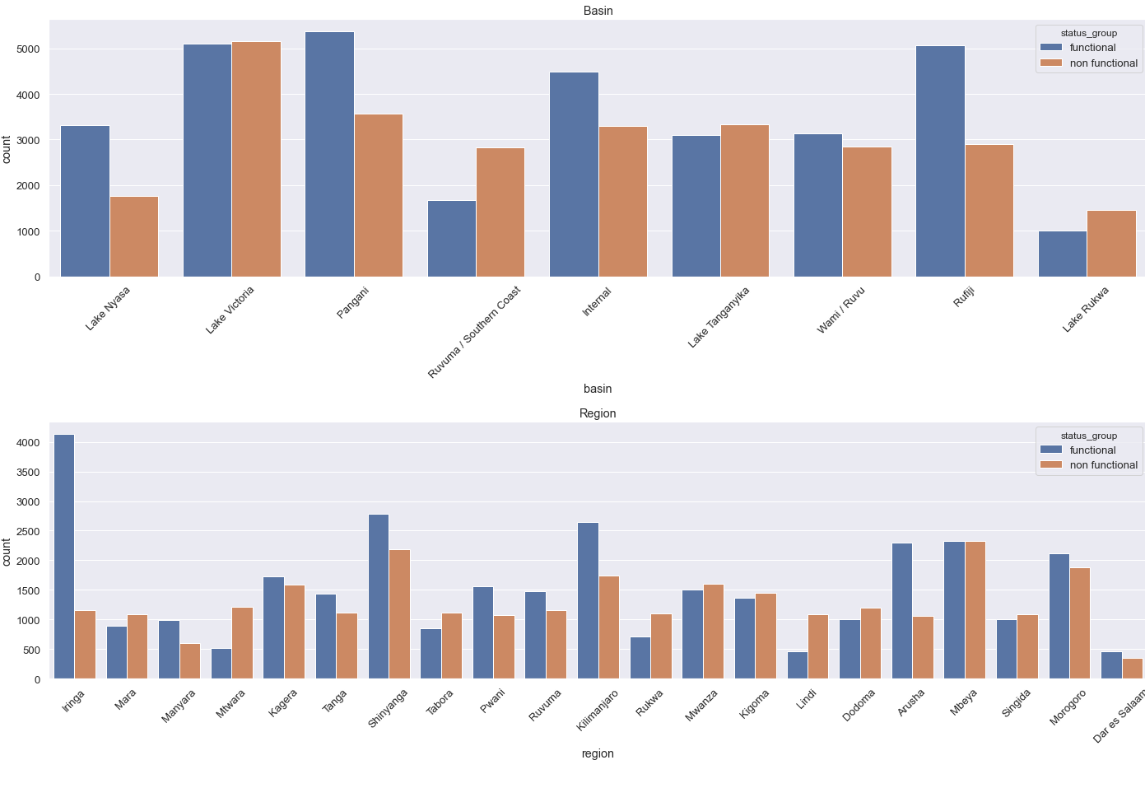
Pump waters varies per region or districts

Slide 10
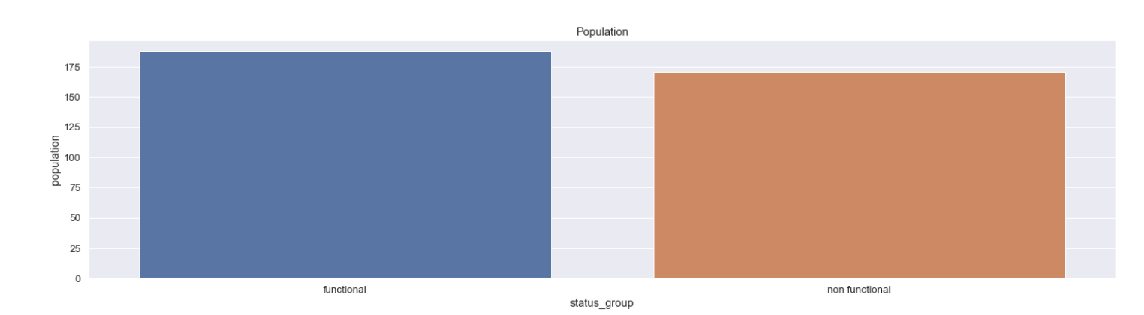
Population has not much effect on pumps

Slide 11
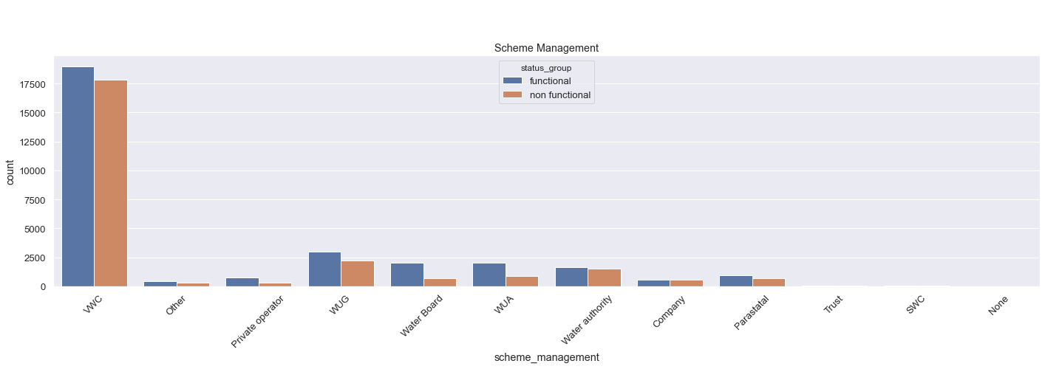
Management types are dominant on one party

Slide 12
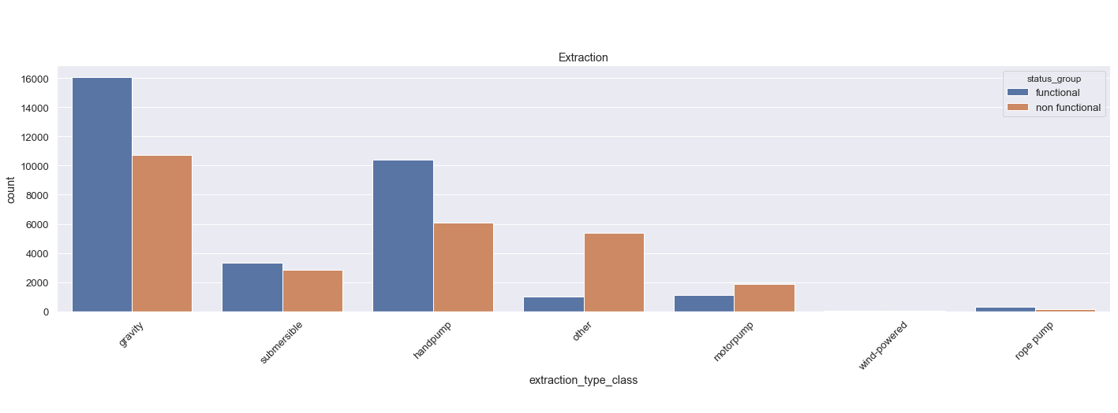
Gravity extraction is main technique used

Slide 13
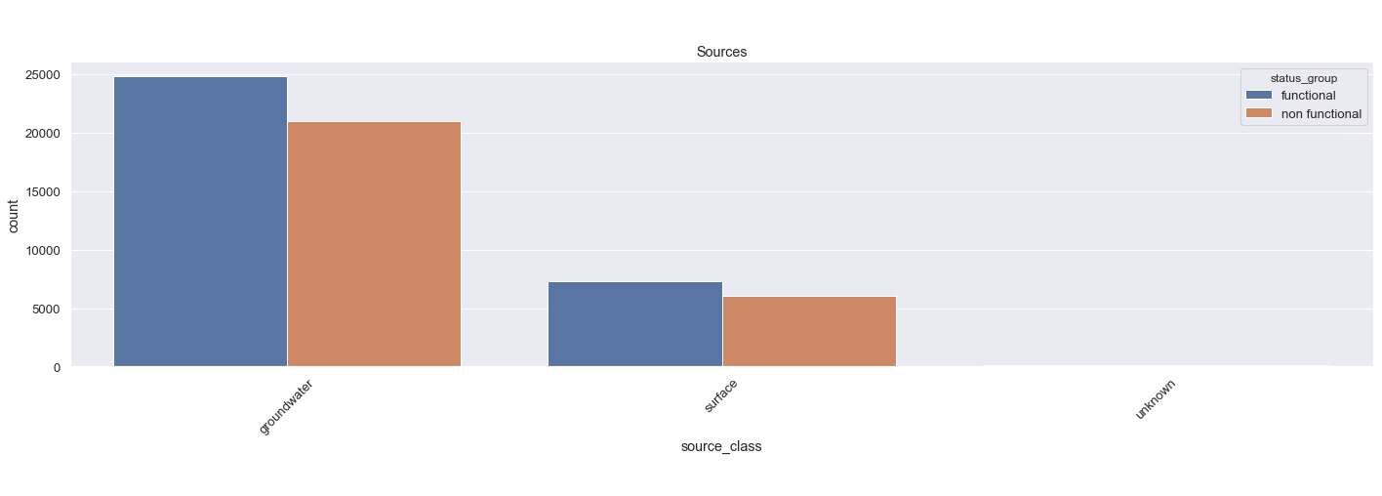
Ground Water sources are most common

Slide 14
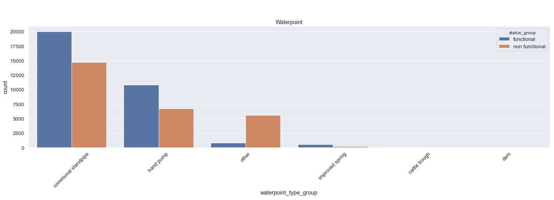
Standpipe types are most common

Slide 15
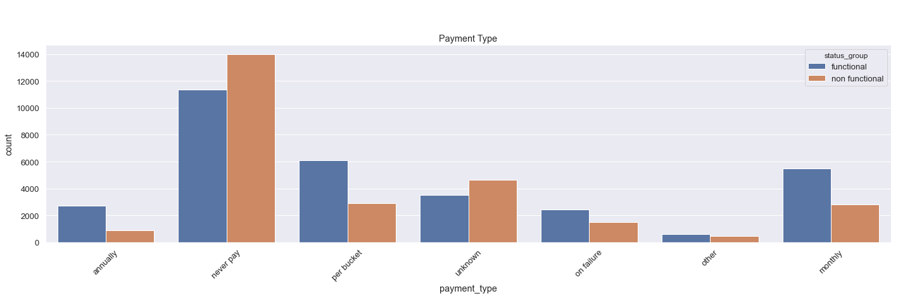
No water payment disrupts water pumps

Slide 16
Insights Discussion

Slide 17
Comparing with initial hypothesis
Basins, Regions and Districts has influence on water pump operations.
Population are more or less similar in numbers and did not much affect water pump operations, hypothesis is rejected
Extraction of water, sources and waterpoints are inconsistent, hence the hypothesis don’t stand

Slide 18
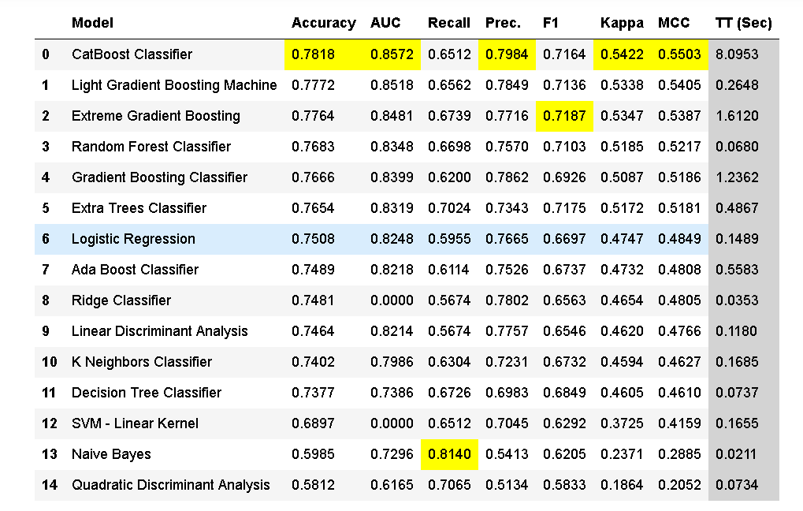
Model and Metrics
Metrics | Functional | Non Functional
Precision | 0.76 | 0.80
Recall | 0.87 | 0.65
F1-Score | 0.81 | 0.72
Accuracy | 78%
AUC | 0.85
We use XGBoost Model for prediction.

Slide 19
Recommendations and Actions

Slide 20
Summary
We have created the project proposal and establish initial hypothesis.
Dataset is explored and added visualizations for clarity
A recommended machine learning model was created to predict water pump operations in Tanzania

Slide 21
Recommended Actions
Areas which has sparse water pumps may need to be increased for consumption
Revamp or restructure water pump management companies
Explore other methods of water extraction
Possible to include other water sources?
Conversion to waterpipes for easy distribution if possible
Water pricing revision to allow affordable payment

Slide 22
Thank you

Slide 23
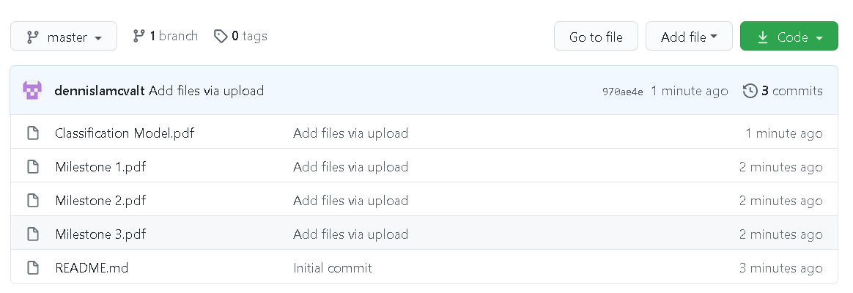
Appendix: PDF Reports Download
GitHub Link: https://github.com/dennislamcvalt/SQLforDataScienceCapstone

